Slide 1
Deaths by Natural Disasters Worldwide
Bridget Groble, Kyle Kohlmeyer, Eileen Fey
Notes:
Introduce ourselves

Slide 2

Natural Disasters are Increasingly Affecting the Global Population
Why should you care about natural disasters?
They are costly¹
The U.S. spent over $100 billion dollars on natural disasters in 2023
Globally, these costs exceed $2.65 trillion
They are becoming more frequent and more extreme²
Over the last 10 years, the U.S. has seen more billion-dollar natural disasters than ever before
They are affecting more and more people³
Notes:
Bridget - why we chose to look at this/ask this question
We all know anecdotally that natural disasters are getting “worse,” but what exactly does that mean? We also keep hearing of places seeing ‘novel’ disasters, or disaster types in areas that have not seen that disaster type before. What are the numbers behind it? What does the geographic distribution look like?
Finally, and most importantly, the disasters are becoming more deadly > this is the focus on our project and in the next few minutes we hope to show you how we took the statistics of deaths as a result of natural disasters, worldwide and turned it into an interactive visualization.
** add footnote for stats:
See Jacobo and Manzo from ABC News.
See NOAA NCEI Data.
See Gusner from Forbes Advisor and “People affected by natural disasters”

Slide 3
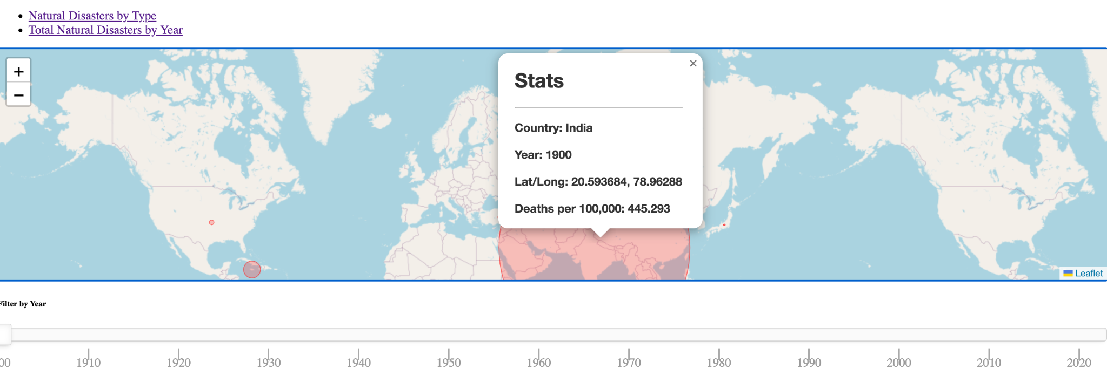
Deaths by Natural Disasters Worldwide 1900 - 2023
Notes:
Eileen
Discuss how a user would use and interact with the project

Slide 4
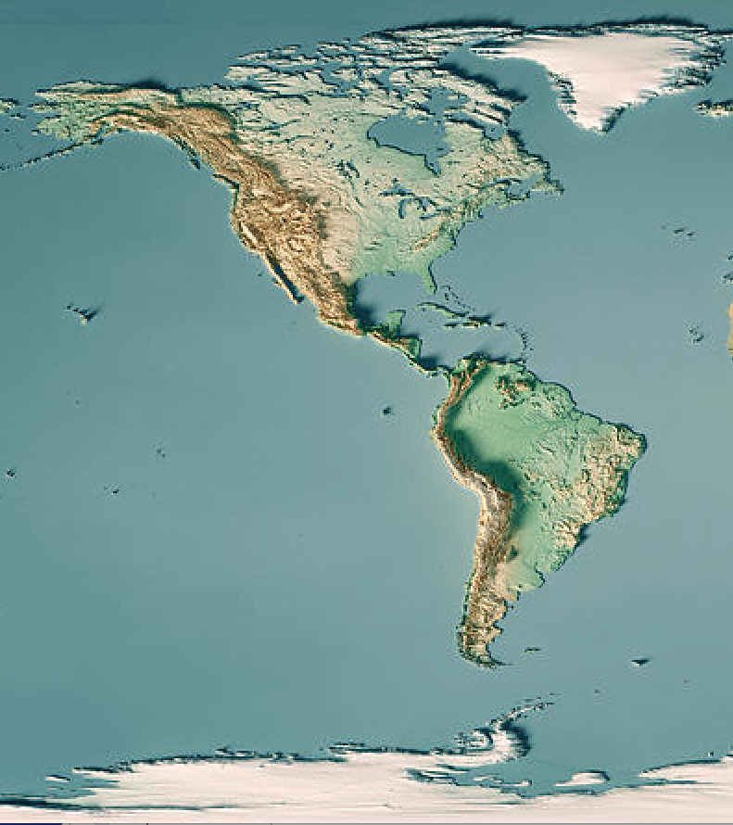
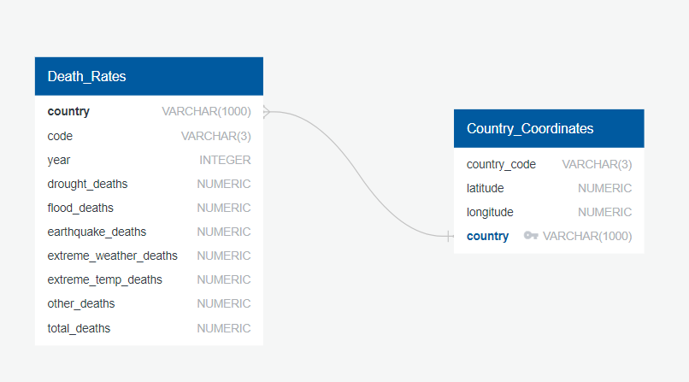
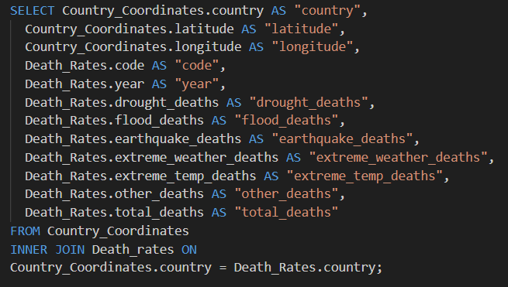
How We Designed Our Code
Part 1: Using SQL to join our data
Notes:
Data cleaning:
A bunch of old countries that no longer exist had to be removed
SQL join couldn’t be executed until all country names were standardized
Whole purpose of the SQL Schema and code was to pair each country with its latitude and longitude data

Slide 5
How We Designed Our Code
Reading in the CSV
Dropdown menu creation
For loop to process the country data
Style changes based on selections
Changes to the HTML for dropdown menu
Part 2: JavaScript to create the webpage
Notes:
Open VS Code to show everyone
Bridget can talk about CSV, Dropdown, for loop, and style

Slide 6
How We Designed Our Code
Automatic refresh
Why this is a BIG deal
Yearly slider
Library used
Relevant changes to the HTML
Part 3: JavaScript continued
Notes:
Eileen discuss this

Slide 7
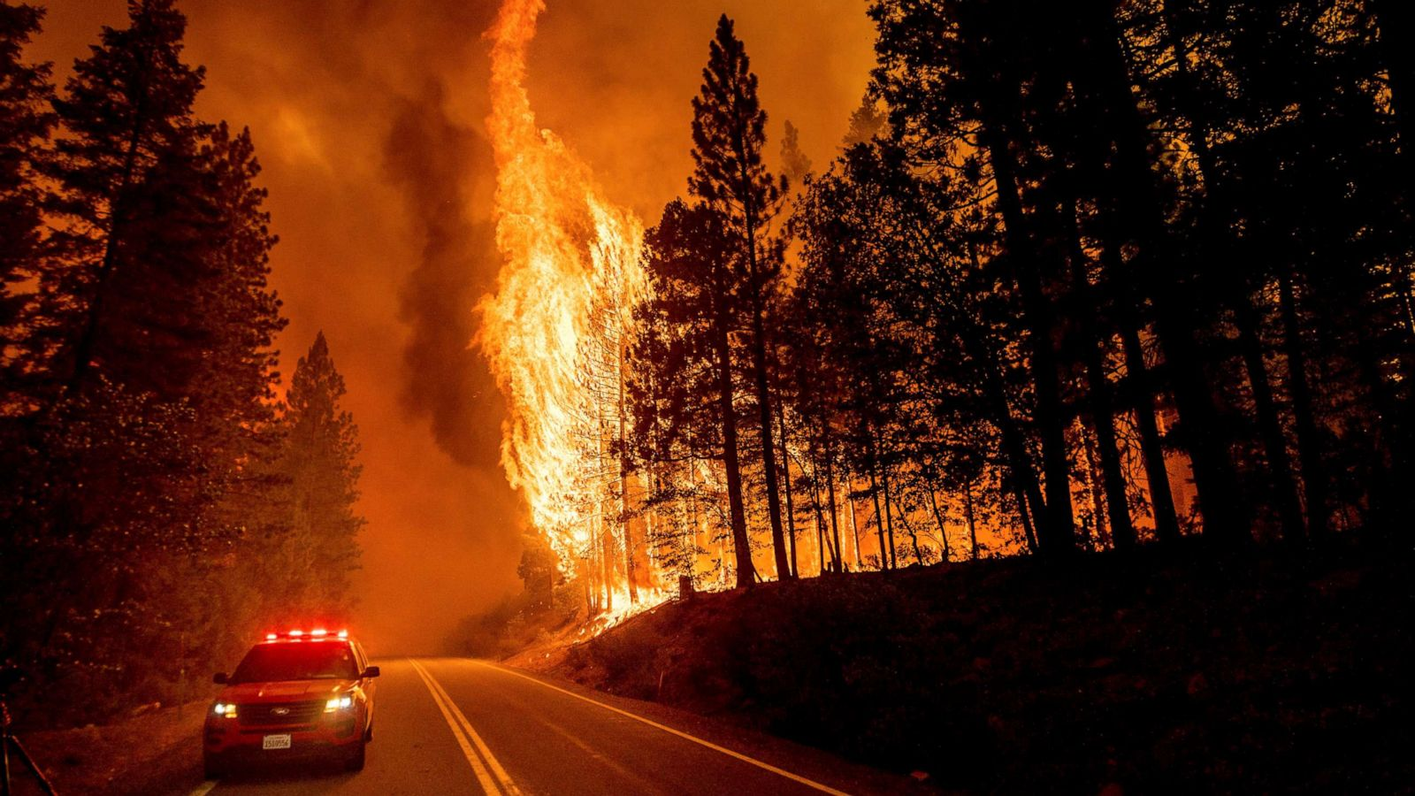
Project Considerations & Limitations
Over the last 123 years, natural disaster deaths have decreased
However, the main categories deaths decreased in were:
Droughts
Floods
Other natural disaster types have seen an increase in deaths
Since 1965, natural disaster deaths have been increasing
Discussion of data cleaning and management
Data is structured as deaths per 100,000 people, inherently providing limitations
Countries and borders change over time, hard to get exact counts for each country over time
Limitations
Visualizations are as extreme as you style them to be
Lessons learned
It’s important to always ask questions of your data and ask “does this look/sound right?”
Notes:
Bridget - 1st and 3rd bullet point
Kyle - 2nd and 4th bullet point
Data cleaning done:
Changed titles of columns describing different types of deaths
summed columns of deaths for fog, dry mass movement, glacial lake outbursts, volcanic activity, wildfire, landslides for “other” column
Removed extraneous columns
Long/lat data - removed USA States data
Incorrect Cape Verde data omitted

Slide 8
Future Research Questions
How many people each year are affected by natural disasters? How to define this?
Injury, homelessness, famine, etc.
Which geographic areas have seen an increase in natural disasters?
How do natural disasters relate to [fill in the blank]? (To measure the impact of climate change)
Increased temperature
Increased rainfall
Amount of greenhouse gases being emitted and/or found in the atmosphere
Notes:
Eileen

Slide 9
References
EM-DAT, CRED / UCLouvain (2023); Population based on various sources (2023) – with major processing by Our World in Data.
“Droughts” [dataset]. EM-DAT, CRED / UCLouvain, “Natural disasters”; Various sources, “Population” [original https://ourworldindata.org/grapher/death-rates-from-natural-disasters?time=1942..latest.
EM-DAT, CRED / UCLouvain (2023) – processed by Our World in Data. “People affected by natural disasters” [dataset]. EM-DAT, CRED /
UCLouvain, “Natural disasters” [original data]. Retrieved March 3, 2024 from https://ourworldindata.org/grapher/total-affected-by-natural-disasters.
Ferreira Costa, Carlos. (2020). Revisiting disasters in Cabo Verde: A Historical Review of Droughts and Food Insecurity Events to Enable
Future Climate Resilience. 55. 47-76.
Gusner, Penny. Forbes Advisor, Forbes Media LLC, 7 June 2023, https://www.ncei.noaa.gov/access/billions/. Accessed 2 March 2024.
Jacobo, Julia, and Daniel Manzo. ABC News, ABC News Network, 28 Dec. 2021,
abcnews.go.com/US/year-climate-extreme-weather-events-prove-climate-change/story?id=81771045. Accessed 2 March 2024.
NASA. Satellite Image of Hurricane. 2020.
https://www.boatus.com/expert-advice/expert-advice-archive/2020/september/how-not-to-read-a-hurricane-map.
NOAA National Centers for Environmental Information (NCEI) U.S. Billion-Dollar Weather and Climate Disasters (2024).
https://www.ncei.noaa.gov/access/billions/. Accessed 2 March 2024.
Saint Louis Science Center. Extreme Weather. 2024. https://www.slsc.org/omnimax-films/extreme-weather/.

